Slide 1
A Strategy to Support the Efficient Development and Use of Innovations in Personalized and Precision Medicine
Personalized Medicine Coalition
Policy Committee Meeting
December 12, 2018
Lou Garrison, PhD, Professor Emeritus
Department of Pharmacy, University of Washington
Adrian Towse. MPhil, MA, Director
Office of Health Economics, London, UK

Slide 2
Agenda
The Question
Current Basic Economics of Innovative Medicines
Barriers to Personalized Medicine
ISPOR Special Task Force on Value Frameworks
Goal
Six Crosscutting Policy Principles
Augmented Cost-Effectiveness Analysis
Indication-Specific Pricing
Combination Products
Methods to Support Decision Making
Conclusion

Slide 3
The Question:
What are potentially transformative strategies and methods aligned with personalized medicine/precision medicine (PM/PrM) to define and measure value at all levels of decision making?

Slide 4
Current Basic Economics of Innovative Medicines
Industry productivity is flat despite growing investments.
Cost per NME is rising.
Health systems are struggling to deal with high prices.
Manufacturers are receiving declining returns—on average.
Development is moving toward more specialized and orphan drugs.
Significant scientific advances are affecting opportunities : immuno-oncologic, gene, and cell therapies, cures, combination treatments.
Rewards are not strongly correlated with health gains delivered.
U.S. prices are rising relative to other countries.
All of this has led to greater interest in “value frameworks” and HTA.

Slide 5
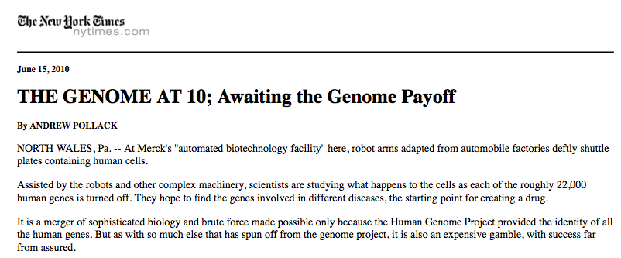
Questions—10 Years After the Genome

Slide 6
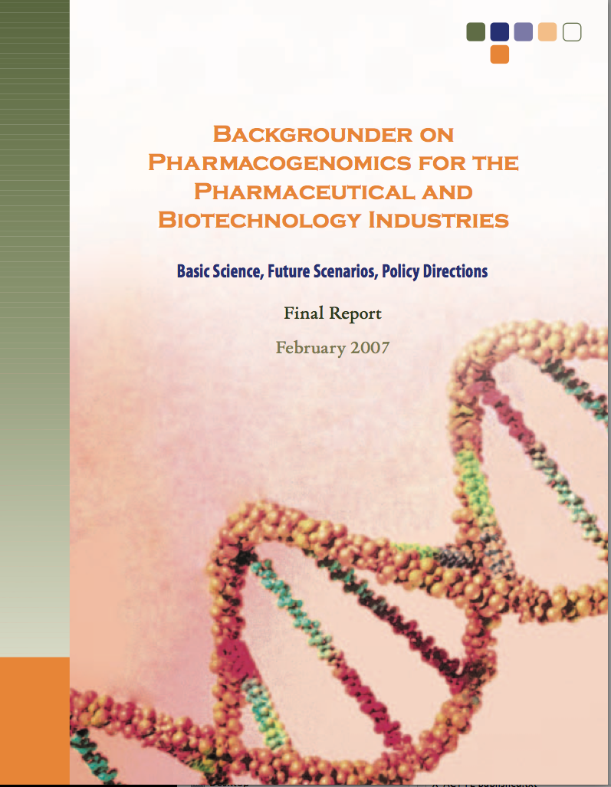
Personalized Medicine: 2005 Futures Forecast for 2015
By 2015, approximately 10 years from now, a variety of test kits using various biological markers testing will be feasible when rapid test results are needed.
Yet, the discovery and validation of pharmacogenomic associations will likely continue at a similar measured pace. A notable development will be the identification of clinically useful pharmacogenomic associations in drug development trials outside of oncology.
We expect that 10 to 15 pharmacogenomic tests will be in routine use in clinical practice.
Although the majority will continue to be in oncology, evaluating both tumor and patient genetics, several tests outside of oncology will be used by primary care clinicians to guide treatment decisions.

Slide 7
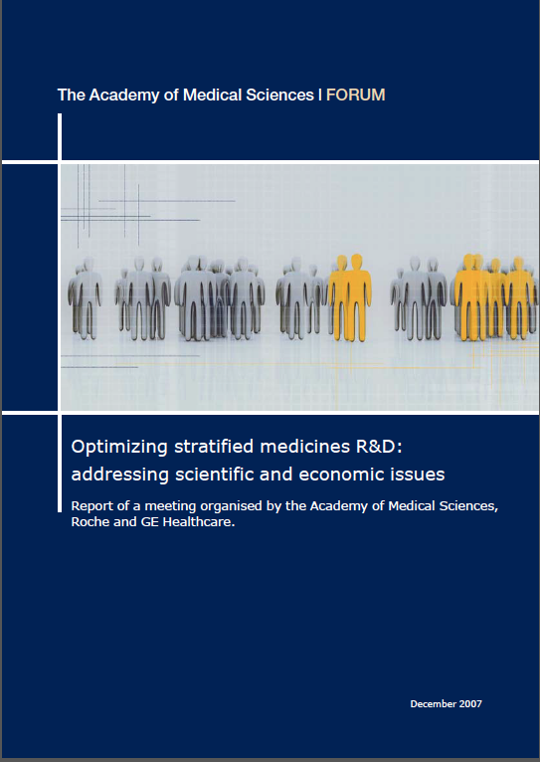
UK Academy of Medical Sciences Report (December 2007)
Key Message #1.
It is essential, for societal as well as
pharmaceutical company benefit, to relate therapeutic incentives to pricing flexibility.
Incentives could be linked to value defined after a conditional approval period – the strategic options need to be clarified.

Slide 8
Apportioning the Value in Stratified Medicine: UK Academy of Medical Sciences Report (July 2013)
Recommendation 14: Flexible, value-based pricing and reimbursement system
Recommendation 15: Incentivising stratification by defining rewards for innovation
Adjust prices over time—for increases and decreases in value
Need to be able to handle single biomarker and large platform multiple biomarker tests
Should consider cost per QALY and cost-offsets
But also consider:
Value of greater certainty of response
Value of improved adherence
Value of great uptake
Develop a model to separate the value between drug and diagnostic
Consider the medicine as the primary source of health gain in responders
Consider diagnostic as the source of cost savings and health gains from avoiding adverse events in non-responders and of increased certainty of response
Divide value of better adherence and uptake similarly between the two

Slide 9
Value Frameworks
Key U.S. Value Frameworks to Date
&
PCSK9 Report
2014
2015
2016

Slide 10
Recommendations of the ISPOR Special Task Force on U.S. Value Assessment Frameworks
[
Final Report
February 2018

Slide 11
Decision Contexts and Value Frameworks
Source: STF Final Report, Section 2 (Garrison, Pauly, et al, Value Health, Feb. 2018)

Slide 12
I: Be explicit about decision context and perspective in value assessment frameworks.
STF Six Major Recommendations
II.2. Frameworks that focus on coverage/reimbursement should consider cost per QALY, as a starting point
II.3. Consider elements not normally included in CEAs (e.g., severity of illness, equity, risk protection) but more research needed.
II: Base health plan coverage and reimbursement decisions on an evaluation of the incremental costs and benefits of healthcare technologies as is provided by cost-effectiveness analysis.
III: Develop value thresholds to serve as one important input to help guide coverage and reimbursement decisions.
Source: STF Final Report Section 7 (Garrison, Neumann, et al, Value Health, Feb. 2018)

Slide 13
IV: Manage budget constraints and affordability based on cost-effectiveness principles.
STF Six Major Recommendations
V: Test and consider using structured deliberative processes for health plan coverage and reimbursement decisions
VI: Explore and test novel elements of benefit to improve value measures that reflect the perspectives of both plan members and patients.
Source: STF Final Report Section 7 (Garrison, Neumann, et al, Value Health, Feb. 2018)

Slide 14
Goal
To promote “dynamic efficiency”—the optimal development, adoption, and use of these technologies over time
Static efficiency decisions, i.e., about which ones to adopt given a fixed budget, need to be well aligned with other incentives to support this long-term objective.

Slide 15
Six Crosscutting Policy Principles (1-3)
Rewards for innovation should be value-based and flexible over time and across indications.
The concept of value should be based on the microeconomic concept of willingness to pay, and should include, at its core, the value of health gain—in terms of the length and quality of life. But it should also go beyond this.
For rewards to be flexible over time, they must be modifiable in light of new real-world evidence (RWE) as well as the emergence of competing new technologies.

Slide 16
Six Crosscutting Policy Principles (4-6)
The scientific information embedded in PM and PrM technologies is a global public good (i.e., all countries could use it, in principle, without using it up). This means that everyone has stake in supporting the required R&D.
Reward systems need to recognize that the diagnostic (Dx) technologies that make PM and PrM possible are technically “economic complements” to the other inputs.
Given the fundamental arbitrariness of splitting the rewards among inputs that are complementary in a static sense, reward systems for PM and PrM will need pragmatic rules that align dynamic stakeholder incentives across technologies and decision contexts.

Slide 17
What is (Economic) “Value”?
From an economic perspective:
Value is what someone is (actually) willing to pay or forgo to obtain something (opportunity cost)
Implications:
Value varies across individuals, across indications for the same medicine, and dynamically over time
Value is difficult to measure in health care because of insurance
In principle, we would ask a plan member about their willingness to pay the incremental insurance premium (or taxes). In practice, the amount is too small to be estimated reliably.

Slide 18
Three Key Questions for Value Frameworks
What are the elements of value?
How are they measured, evidenced, and valued?
how are they aggregated and judged to reach a decision on value?

Slide 19
Value
Quality-adjusted life-years (QALYs) gained
Productivity
Severity of disease
Real option-value
Fear of contagion
Insurance value
Value of knowing
Adherence-improving factors
Net costs
Value of hope
Equity
Scientific spillovers
Potential Elements of Value for Augmented Cost-Effectiveness Analysis (ACEA)
Green circles: core elements of value
Light blue circles: common but inconsistently used elements of value
Dark blue circles: potential novel elements of value
Blue line: value element in traditional payer perspective
Red line: value element also included in societal perspective
.

Slide 20
Value Varies by Indication
Trastuzumab for HER+ Breast Cancer:
Indication-Specific and
Combined Life-Cycle Cost-Effectiveness Ratios, 2010.

Slide 21
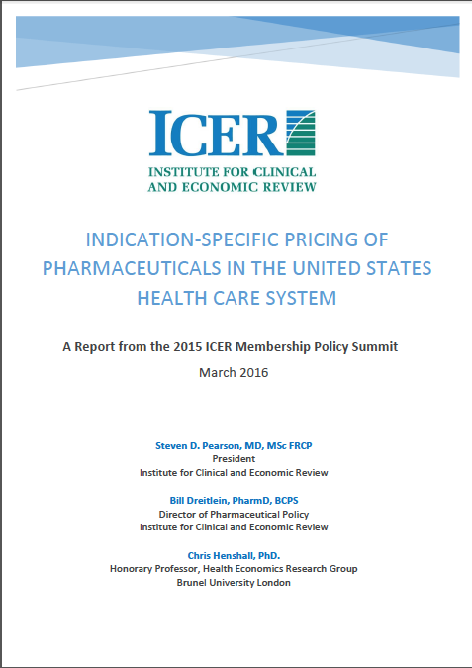
Indication-Specific Pricing: Implementation Issues—U.S.
Necessary conditions:
Drug payment system with a commitment to a value-based rewards for encouraging innovation.
A RWD infrastructure that supports measurement of use and of outcomes over time.
An administrative system that supports differential pricing, e.g., differential discounts by indication.
Overcoming many administrative barriers:
ICD-10 and J-codes
Medicaid best price, 340B, ASP
Multiple payers—private and public
Regulation of off-label use

Slide 22
Value Attribution for Combination Treatments
Combination treatments involve “complementary” goods or inputs.
In a static sense, the value created is a product of the synergy of the inputs: it may be impossible to identify the marginal contribution.
The value created for the consumer (i.e., patient) is not specific to one input: hence, the division of rewards among the inputs is essentially arbitrary.
E.g., ham and cheese panini (3 inputs + labor)

Slide 23
Rewarding Innovation in Medicines—Principles and Implications
The key principle or philosophy for rewarding innovation via patents for medicines is that innovators receive the “value of their marginal product” (VMP) during their patent life, subject to competition within a drug class.
Implication: Indication-specific rewards--at a minimum, payment should be tied to an indication as the VMP will vary by indication
Challenge: administering this requires (a) real-world data (RWD) on use by indication, and (b) ideally RWD on outcomes and thus the VMP (i.e., cost-effectiveness)

Slide 24
Methods to the Support Decision-Making
Include more attributes in the health state descriptions that underlie health state utility estimation
Move toward a “net monetary benefit” comparison by monetizing the QALY and adding the incremental value of the additional elements
Use multi-criterion decision analysis (MCDA) to estimate weights through a group process
Use other structured deliberative processes that vote based on non-integrated information

Slide 25
Conclusion: Strategy with Five Key Elements
Broaden the concept of value to better identify and reward the contribution of PM/PrM Dx;
Reform how we measure and reward value creation in PM/PrM
Invest more in RWE generation for PM/PrM;
Implement value-based, flexible indication-specific pricing
Align value metrics across different decision contexts built on health benefit based on patient-centered utility.

Slide 26
Acknowledgements:
Thanks for your attention!
lgarrisn@uw.edu

